Slide 1
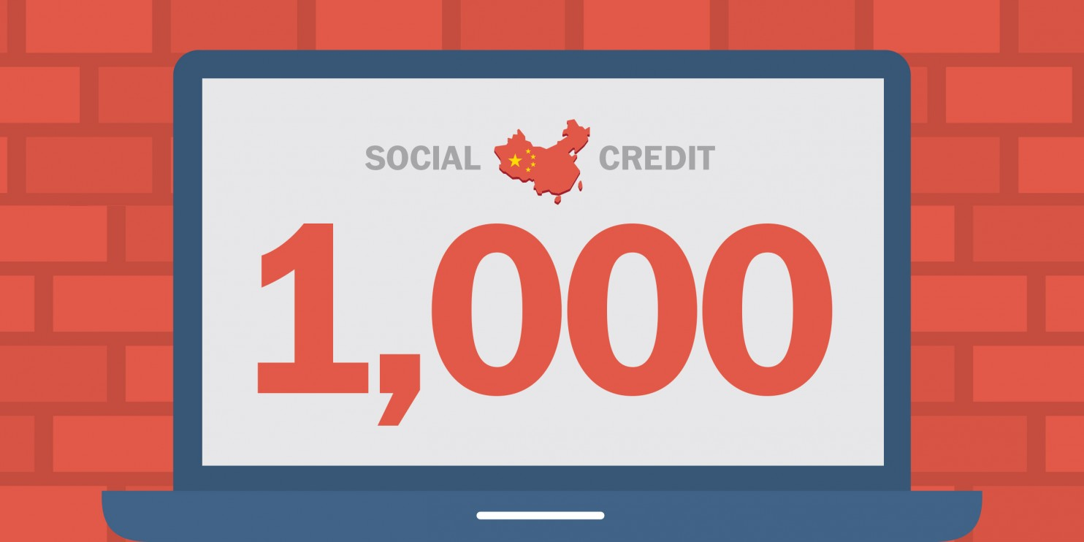
The Social Credit System (SCS) and its impact on economic growth of clothing manufacturing companies in China

Slide 2
Research Question
How does the social credit system (SCS) affect the credit and investment behavior of Chinese clothing manufacturing companies?
High barriers for companies on black lists
Lack of government resources
Restrictions on travel
Attractive perks for companies on red lists
Government subsidies
Government low interest loans
Fast lane to government bureaucracy
Existing studies
Rogier Creemers “China’s Social Credit system: An Evolving Practice of Control”
Notes:
Even though the SCS affects individuals as much as businesses, we will look at the effects of the program on the businessees
Few papers high levels of public favor of the SCS system (2019) [4]

Slide 3
What is China’s social credit system?
A financial and social reputation system involving citizens and businesses resulting in rewards and punishments (enabled by big data)
Good Things “Red-List”
Good Deeds
Paying taxes on time
Community service
Operating reputable businesses, etc.
Low interest bank loans
Government subsidies
Expedited government processes/bureaucracy
Notes:
“allow the trustworthy to roam everywhere under heaven while making it hard for the discredited to take a
single step.”
Highlighted ones that directly affect a business, owning a business, running a business
“3 dozen pilot systems have been dolled out”

Slide 4
What is China’s social credit system? (cont.)
Bad Things “Black-List”
Bad Deeds
Counterfeiting
Bribery/Corruption
Food safety issues (employers)
Mistreatment of workers
Bans on:
Travel
Creating new companies
Receiving stock options
Gov’t employment
Gov’t subsidies
Purchasing real estate
Permits
These restrictions have massive implications on economic growth in business and consumer behavior!
Notes:
“allow the trustworthy to roam everywhere under heaven while making it hard for the discredited to take a
single step.”
“3 dozen pilot systems have been dolled out”

Slide 5
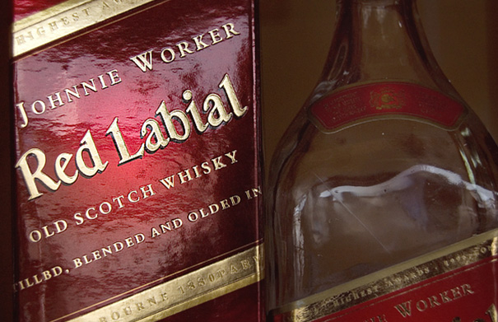
Why is this social credit system necessary?
To create trust in the marketplace and legal system
Examples of issues:
Intellectual Property Right Violations
Rampant counterfeiting
Corruption
Tax evasion
Only 2% pay personal income tax (Nov. 2018) [1]
Driven by cash economy/lack of enforcement
Food safety issues
Baby formula Scandal (2008)
Tainted with melamine → 300k babies sick [2]
Fake Vaccines (2018)
~1 million defective vaccines [3]
Why is this happening? Let’s look at a brief history of the cultural revolution
Notes:
Despite china being the 2nd biggest economy in the world and millions of people being lifted out of poverty in recent years, there have been systematic problems in enforcing laws, where do these problems come from? We have to look back a couple of decades to Mao Zedong and the cultural revolution,
Widespread issues:
Intellectual property rights
Counterfeiting
Corruption
Tax avoidance
Food safety issues
Tainted baby formula
WHY? Remains of values from the cultural revolution

Slide 6
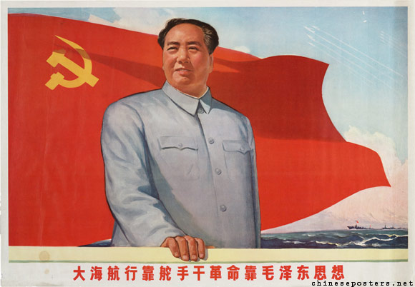
Brief History: Adherence to law
Mao Zedong’s Cultural Revolution (1966-1969)
Rejected formal law as “bureaucratic” and “bourgeois”
Accepted an “informal” law (applied when convenient)
Allowed him to exert power without any opposition
Result of the Cultural Revolution
Great Leap Forward → mass starvation
People do not respect the rule of law or depend on the legal system as conditioned by the gov’t
After Mao’s death (1976): Transition to a market based economy:
Needed to reform the formal legal system to support trust in a market
Difficult transition from rejection of formal laws to abiding by them
Notes:
One significant reason is
“Mao proceeded to have a large number of cadres purged without resort to any formal process…in disregard of constitutional procedure”
“courts still existed but functioned only sparingly”
“in general, “normalcy” appears to have been restored to the legal field by 1973”
“what has emerged from the cultural revolution is the ascendency of the societal model of law over the jural model and more explicit dominance of the Party and the policy in the administration of justice”
“new constitution in 1975”
“the constitution contains provisions weighted towards discipline…on the other…Mao Tse-tung’s mass politics and anti-bureaucratisim”
“consistent decline in the jural model in China since 1957”
“courts appear to be involved in only in serious criminal cases and divorce ligitations”
“serious crimes ie. rape, robbery, corruption, counterrevolutionary…are brought to the courts”
“Law as a political tool to implement Party policy”

Slide 7
Experimental design
Goal: Effect of SCS treatment on economic growth outcome (credit and investment) at the company level
Background: Gov’t will finish planning outline for the SCS Program in late 2020
36 pilot cities exist as of April 2018. National roll-out after 2020.
Clustered Randomization at City Level (outcomes on the company level):
After planning period is finished in 2020
Clustered RCT with a sample size of 60 manufacturing cities (30 cities on SCS treated and 30 control cities)
Stratified Sample: 60 Tier III Cities (e.g. Weifang, Baoding, Yangzhou)
Not as developed as cities like Beijing, but still significant economically
GDP of USD $18-67 Billion
Population of 150k to 3 m
Timing: 10 year study from January 2021 to January 2031
[5]
[5]
Notes:
NEED SAMPLE SIZES, research that, for power calculations and MDE
Assume that the rollouts will be much larger after the planning period is done
China has 600 cities
Similarity in size and economic
Clustering in cities helps a lot with spillover effects and externalities
Average number

Slide 8
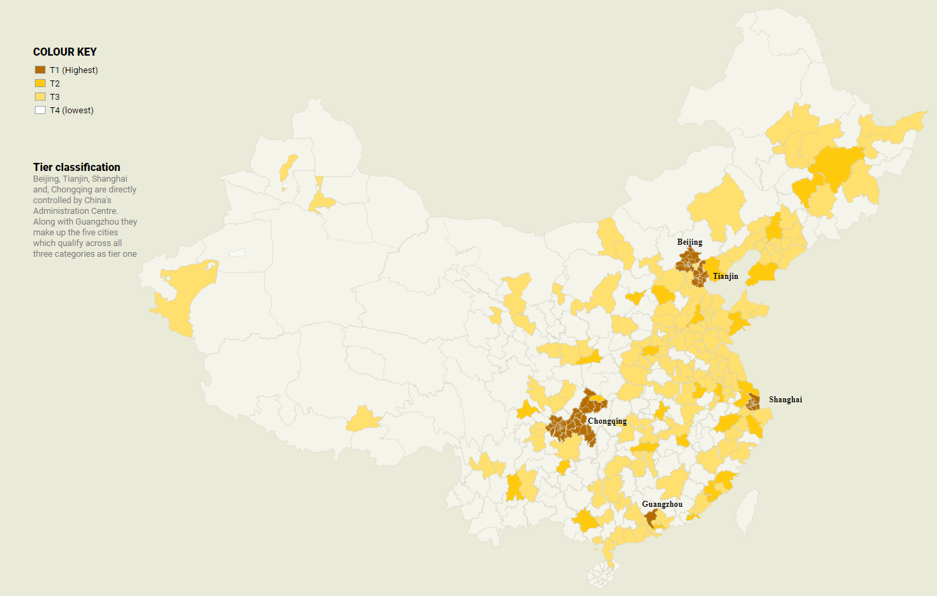
Informally Tiered Cities in China
[5]
Notes:
Grouped by GDP, political administration (central gov’t, provincial, prefectures, counties)
Tier III has 70 cities, 18-67 billion, run by prefecture governments, and 150k to 3m people

Slide 9
Experimental design (cont.)
Ensuring baseline balance:
Stratified sample for Tier III cities
Similar GDP, political structure, and population
Negating differences in manufacturing sectors between cities by focusing on specifically clothing
Generic and non-unique industry
Use T-test to check baseline characteristics of T&C cities such as:
GDP
Population
Growth rates of companies
Consider re-selecting Tier III cities based on these results

Slide 10
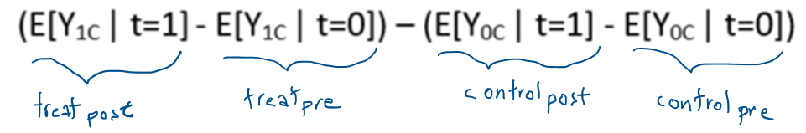
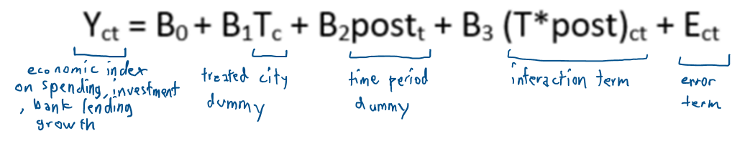
Experimental design (cont.)
Difference in difference (DID)
Baseline characteristics of the 60 cities will be taken at the start of 2020
Remove time invariant differences between cities (C)
OLS Regression
Notes:
Outcome variable is an aggregate economic indicator of revenue, spending, investment, and
Do I just difference out between cities

Slide 11

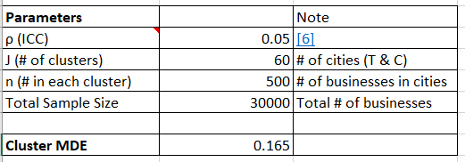
Experimental design (cont.)
Cluster MDE:
Notes:
0.1-.5
Smaller the rho less similar
Credit outcome
Pick subset of firms
MDE = .2 or less
Affect firm behavior – look at studies

Slide 12
Threats to validity
Need multilevel financials and social credit data from government
Assuming Tier III cities are similar enough in characteristics
Tier III cities may be growing faster and vary more than larger developed cities
DID, stratification, large sample size will help
SCS Rollout Behavior is assumed
RCT assumes a fairly large 30 Tier III city rollout after the planning period is over.

Slide 13
References
[1] Simina Mistreanu (April 3,2018). Life Inside China’s Social Credit Laboratory. https://foreignpolicy.com/2018/04/03/life-inside-chinas-social-credit-laboratory/
[2] Tania Branigan (December 2, 2008). Chinese figures show fivefold rise in babies sick from contaminated milk. https://www.theguardian.com/world/2008/dec/02/china
[3] Ben Westscott & Serenitie Wang (Aug 16, 2018) Number of faulty children's vaccines in China surges to over 900,000. https://www.cnn.com/2018/08/16/asia/china-vaccine-scandal-doses-intl/index.html
[4] Genia Kostka (February 13, 2019). China’s social credit systems and public opinion: Explaining high levels of approval. https://journals.sagepub.com/doi/full/10.1177/1461444819826402
[5] Marco Hernández (April 4, 2018). China’s tiered city system explained. South China Morning Post. http://multimedia.scmp.com/2016/cities/.
[6] Li, et all (November 1, 2014). A large-scale cluster randomized trial to determine the effects of community-based dietary sodium reduction. https://www.ncbi.nlm.nih.gov/pmc/articles/PMC3919684/

Slide 14
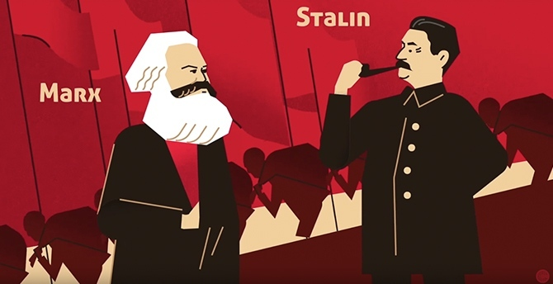
Thank you. Any Questions?
dal2111@bu.edu
David Jan-Liu

